Slide 1
LearnMate – Agentic AI for Personalized Course Pathways
IBM SKILLBUILD PROJECT
Presented By:
Student name : Harshit Prajapati
College Name : Arya Institute of Engineering & Technology
Department : CSE

Slide 2
OUTLINE
Problem Statement
Technology used
Wow factor
End users
Result
Conclusion
Git-hub Link
Future scope
IBM Certifications

Slide 3
Problem Statement
The Challenge - Students often struggle to identify the right learning path that aligns with their interests and long-term goals due to the overwhelming number of online courses and a lack of personalized guidance. LearnMate aims to solve this by acting as an Agentic AI coach that interacts with students, understands their interests (like Frontend Development, Cybersecurity, UI/UX Design, etc.), assesses their current skill level, and dynamically builds a personalized course roadmap that adapts over time based on progress and preferences.

Slide 4
Technology used
IBM Cloud Lite Services
IBM Watsonx.ai Studio
IBM Granite LLM
Watsonx Agent Lab (LangGraph + ReAct)
Vector Indexing for document grounding
Prompt-based conversational AI (No-code)

Slide 5
Wow factors
Dynamic, interest-based learning paths
Auto-adaptive roadmaps through conversation
Grounded recommendations using real docs (TXT/PDF)
Easy-to-use interface powered by Watsonx
No-code deployment using Agent Lab
Helps learners make better, faster education decisions

Slide 6
End users
Students exploring tech career paths
Educators or academic advisors
EdTech platforms & training institutes
Beginners in Frontend, Cybersecurity, Cloud, UI/UX

Slide 7
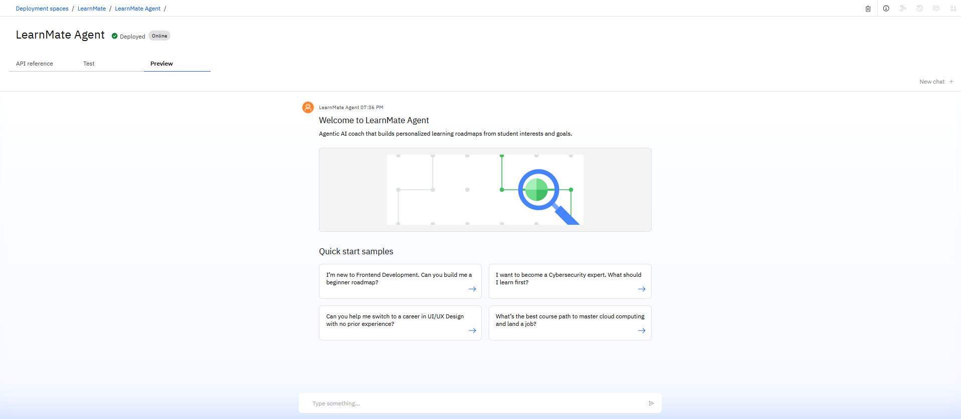
Results

Slide 8
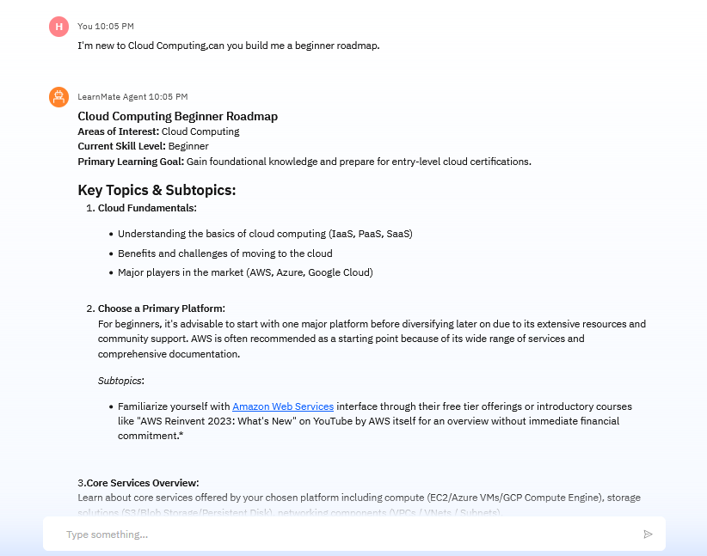
Results

Slide 9
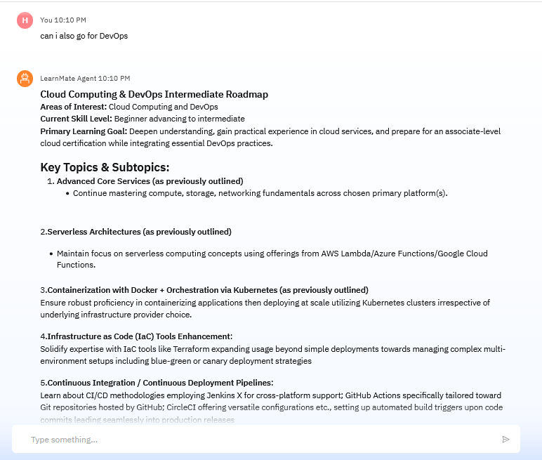
Results

Slide 10
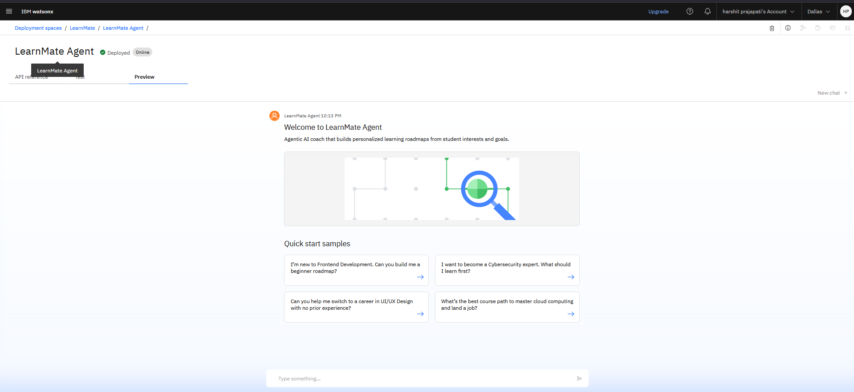
Results
Deployed AI Agent

Slide 11
Conclusion
LearnMate provides accessible career guidance using Agentic AI.
Leverages IBM Granite + Watsonx Studio for personalized planning.
Enables no-code deployment, making it ideal for students and institutions.
Reduces confusion in self-paced learning with adaptive AI-generated plans.

Slide 12
GitHub Link
GitHub Link: github.com/harshit27p/LearnMate-Agentic-AI

Slide 13
Future scope
🎯 Progress tracking via database or session history
🌐 Multilingual and regional learning support
🔊 Voice input for accessibility
📚 Dynamic course updates via APIs
🤖 Agent deployment on web and mobile platforms

Slide 14
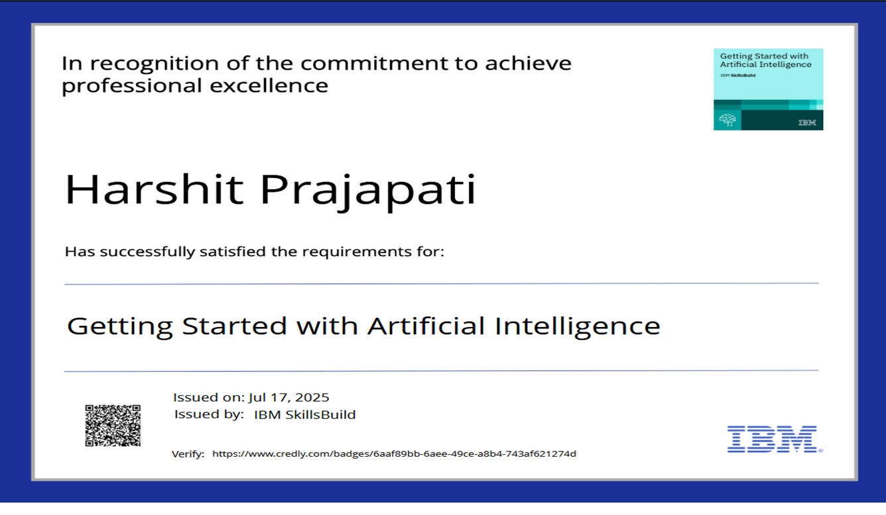
IBM Certifications

Slide 15
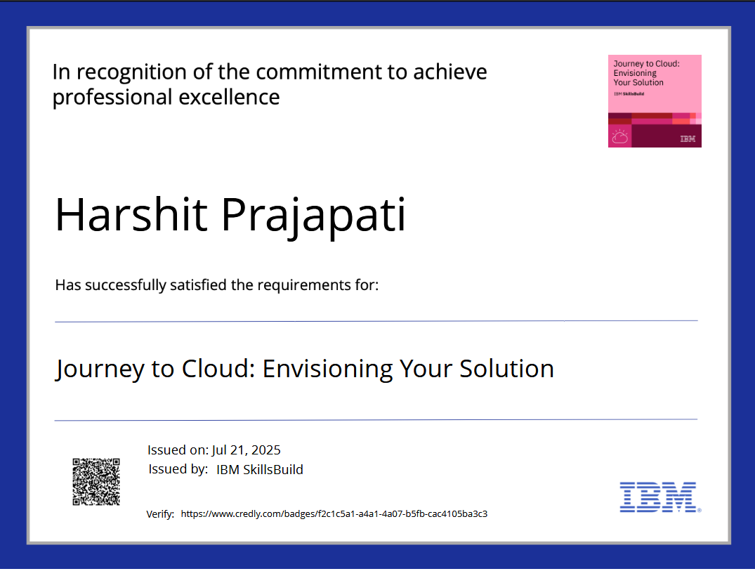
IBM Certifications

Slide 16
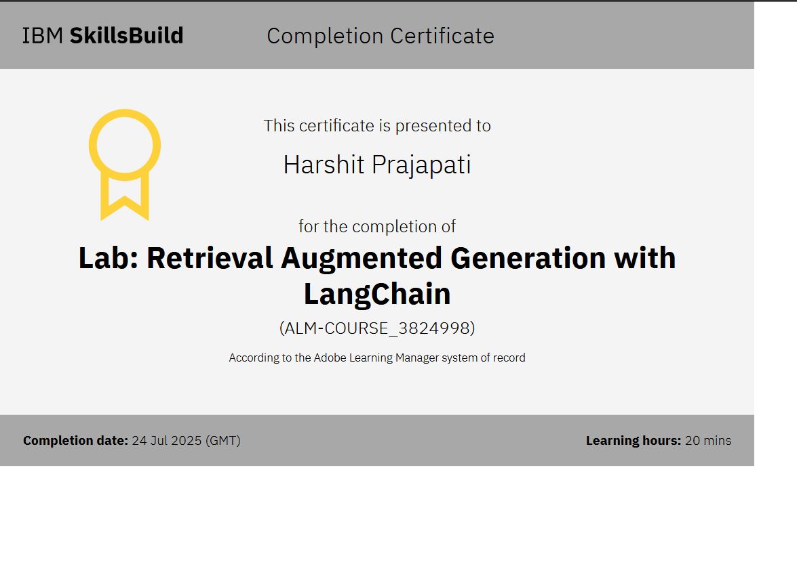
IBM Certifications

Slide 17
THANK YOU

